Slide 1
Autism Spectrum Disorder - Using Eye Scan path
16 Feb 2025
Data Augmentation
Vaishnav Krishna P
Report 2

Slide 2
Outline
  Introduction
  Objective
  Methodology
  Results
  Conclusion

Slide 3
Introduction
The Orginal Dataset includes 547 images with 328 non ASD(Autistic Spectrum Disorder) and 219 ASD images. From the baseline accuracy testing very clear that this many images are not enough to build a good model. So, we apply Data Augmentation techniques.
Data Augmentation Techniques are used to generate synthetic samples by image transformations. Some of the Data Augmentation techniques includes,
  Horizontal flipping
  Gaussian Noise
  Vertical flipping
  Hue/Saturation
  Rotation

Slide 4
Objective
The objective of this experimental setup is to apply various Data augmentation techniques to enlarge our dataset from 547 to 2564 around 4-5 times the orginal dataset by applying various data augmentation techniques.
Note: Since we are dealing with the eye track scan path, we cannot perform horizontal flipping, vertical flipping, large rotation, etc., because it changes the meaning of the data and train model with false data.
  Train the various pre-trained models with the data augmented data,
    MobileNetv2
    ResNet50
    DenseNet121
    EfficentNetv2

Slide 5
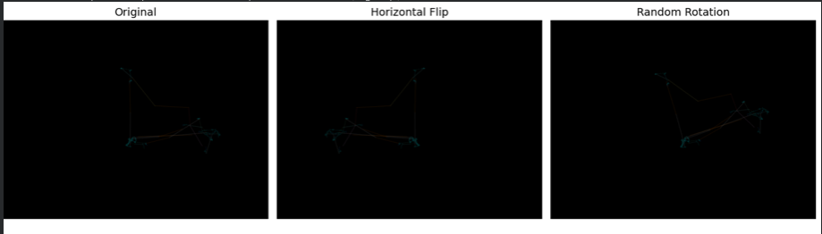
Methodology
Data Augmentation Techniques,

Slide 6
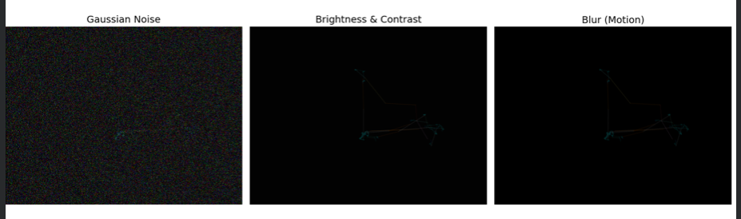
Methodology

Slide 7
Methodology
  The offline Data augmented dataset is generated from the original dataset; the no of images after the augmentation was about 2564 images.
  each image of about 4-5 augmentation
The data augmentation techniques applied in our case are,
  slight rotation
  small horizontal shift
  small vertical shift
  small zoom
  slight brightness change

Slide 8
Experimental Setups
Entire experiments were conducted on Google Colab with a free GPU resources. The parameters used across the experiments includes,
  Test size: 0.2
  Image size: 128*128*3 / 224*224*3(orginal image: 640*480*3)
  Batch size: 16
  Train, Test image size: 2052,512
  hidden layer: 128 neurons(relu activation fn)
  Dropout(0.5)
  output layer: 1(sigmoid activation fn)
  epochs: 20(applied early stopping - callback)
  metrics - accuracy, precision, recall, f1-score, MCC

Slide 9
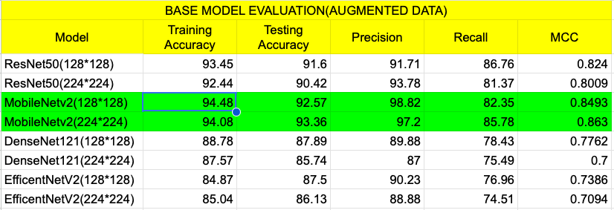
Base accuracy - Data Augmentation

Slide 10
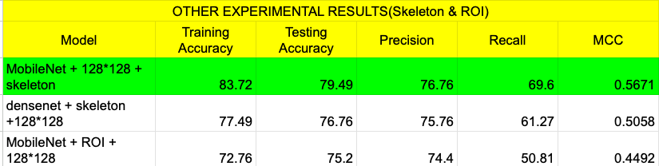
Other Experimetal results
The ROI(Region of interest) & Skeleton image processing techniques were effective techniques for the original dataset. But, when applied after Data augmentation the accuracy drops.

Slide 11
Optimisation of parameters
The MobileNetv2 outperform all the other models with an accuracy of 98.02 after adjusting some of the parameters,
  Test size: 0.2
  Random seed: 41
  Image size: 224*224*3
  Batch size: 16
  Train, Test image size: 2052,512
  epochs: 20(applied early stopping - callback)

Slide 12

Accuracy - metrics

Slide 13
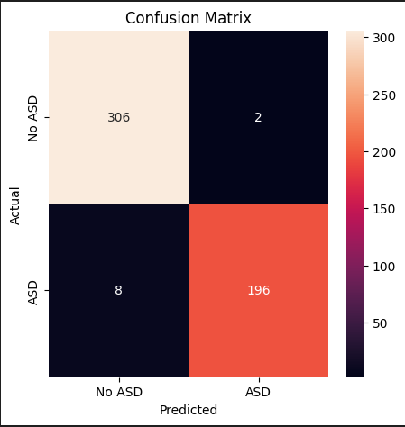
Accuracy - confusion metrics

Slide 14
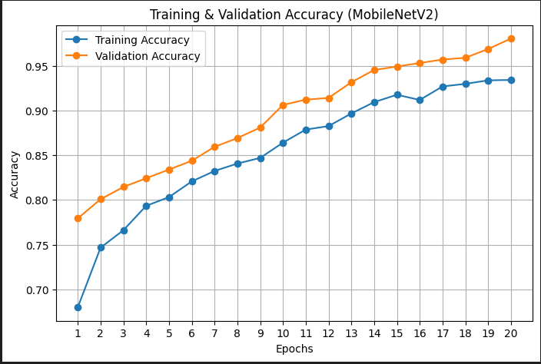
Training & Validation accuracy curve

Slide 15
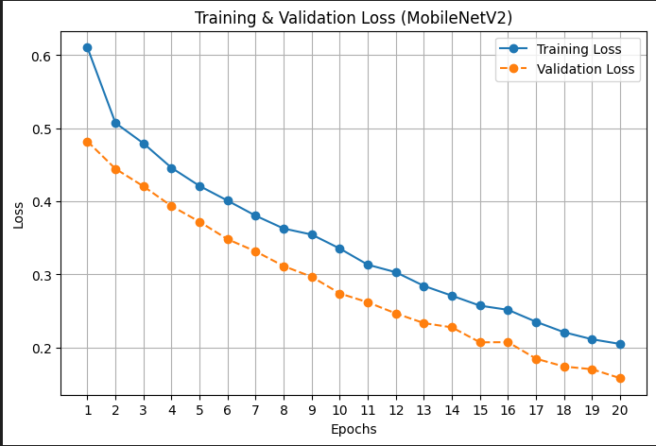
Training & Validation loss curve

Slide 16
Thank you

